Slide 1
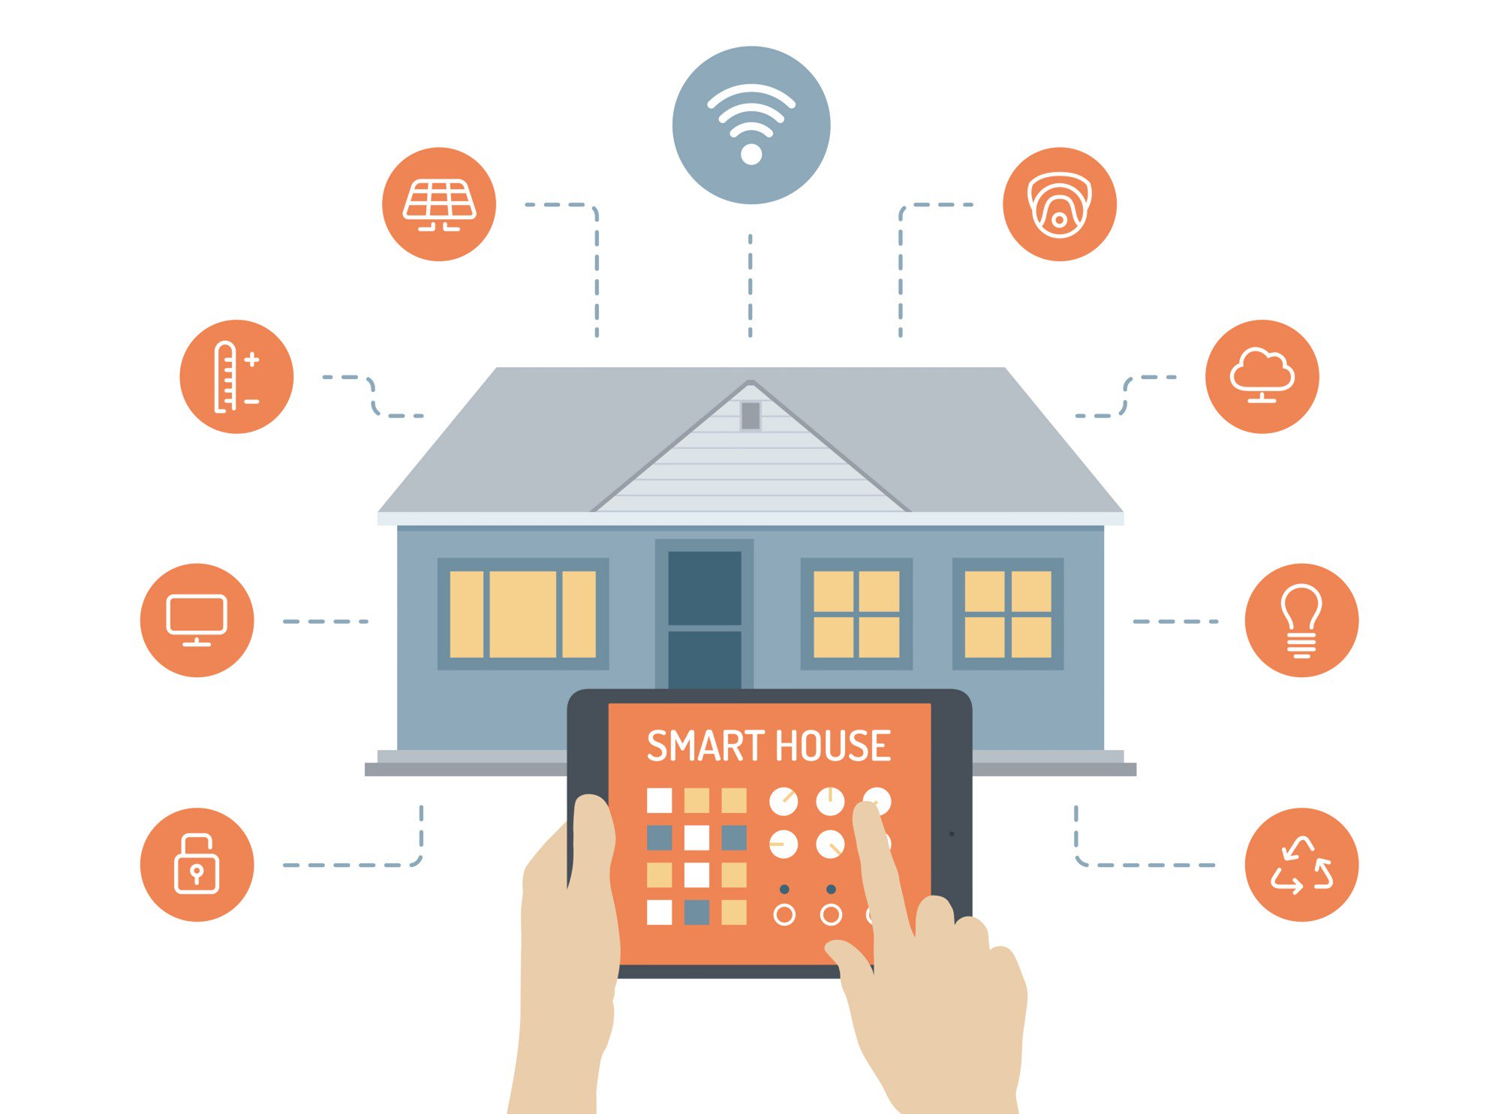
Smart home based on Iot
Sanjana
Department of Computer Science and Engineering
Notes:
NOTE:
To change the image on this slide, select the picture and delete it. Then click the Pictures icon in the placeholder to insert your own image.

Slide 2
Topics to be covered
Internet of Things
1.1 Introduction
1.2 History
1.3 Application of IoT
Smart Homes
2.1 Introduction
2.2 Elements of smart home system
2.3 Challenges & Benefits

Slide 3
Topics to be covered
3. Security system in smart homes
3.1 Structure
3.2 Objectives
3.3 Security risks
3.4 Measures
Scope in smart home technology
4.1 Market Potential
4.2 Ways to improve
Conclusion

Slide 4
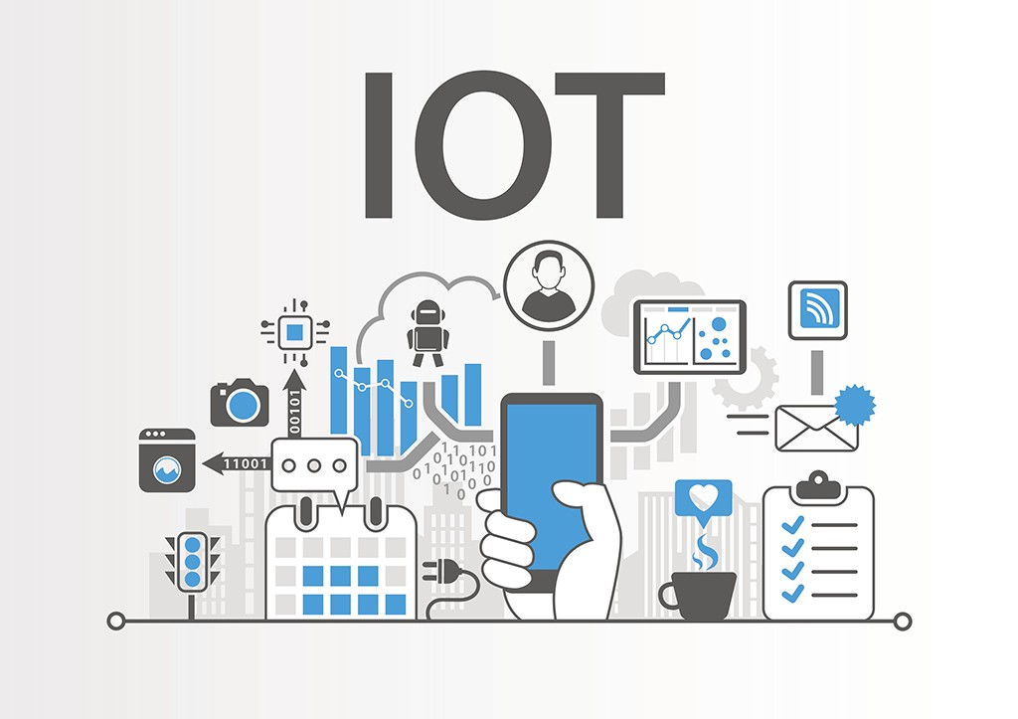
1. INTERNET OF THINGS
Introduction
Internet of things is an integration of heterogeneous electronic devices which are uniquely addressable and controllable by the computers.

Slide 5
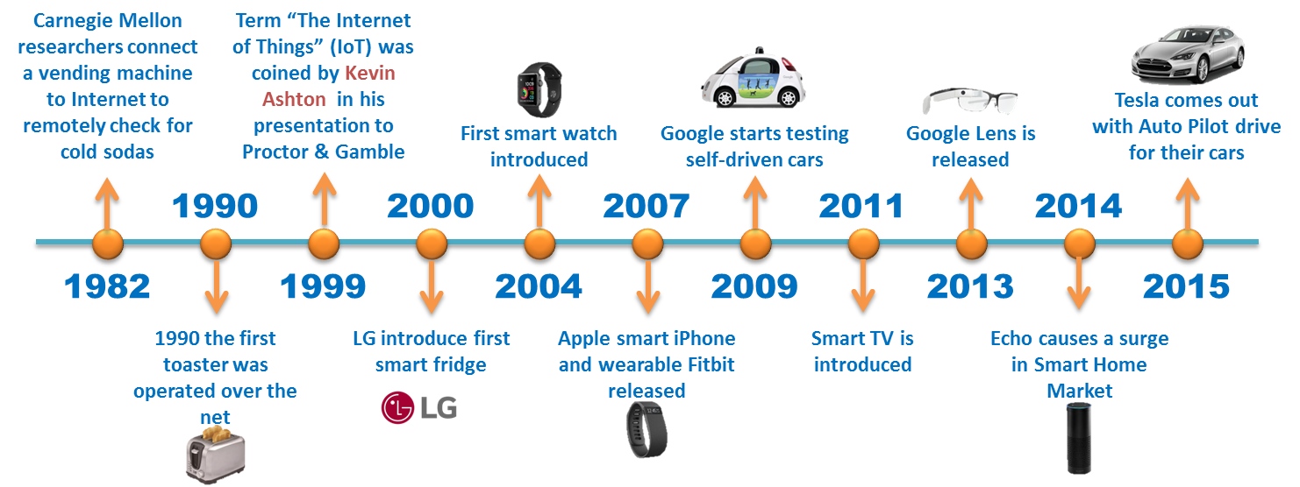
INTERNET OF THINGS
History
The concept of IoT was first introduced to the world in 1982, when a first modified internet connected Coke machine was developed.
The term was first suggested by Kevin Ashton during his work in Procter & Gamble.

Slide 6
INTERNET OF THINGS
Data services
E- Health
Public Security Services
Smart buildings and homes
Enhanced learning
Applications
Applications
IoT has found uses in different fields such as medical and healthcare, environmental monitoring, manufacturing, transportation, media, building and home automation, energy management and many others.

Slide 7
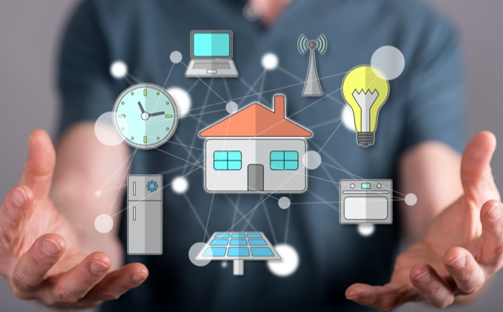
2. Smart home
Introduction
A smart home refers to a convenient home setup where appliances and devices can be automatically controlled remotely from anywhere with an internet connection using a mobile or other networked device.

Slide 8
SMART HOME
Elements of smart home system
Sensor surveillance
Sensor for monitoring temperature, proximity, sound, fire, etc.
User interface devices
Networking
Wired devices such as fibre optic, coaxial cable
Centralizing control
Microcontroller, PLC, computer, FPGA.
Wireless devices like Bluetooth, Infrared, ZigBee, WIFI and RF.
Remote control, computer, smartphones, tablet.

Slide 9
SMART HOME
Centralization
Real-time monitoring and control
Remote access
Assistance
Manages energy consumption
Abnormal alarms
Security
Availability
Signal interference
Not user friendly for a certain group
Benefits & Challenges

Slide 10
3. Security System in smart homes
Architecture of Security levels
There are said to be six layers in the architecture of IoT - coding layer, application layer, network layer, perception layer, middleware layer, and business layer.
A security network in IoT is commonly divided into three layers namely, network layer, perception layer, and applications layer.
Coding layer
Application layer
Perception layer
Middleware layer
Network layer
Business layer

Slide 11
SECURITY SYSTEM IN SMART HOMES
Objectives
Information Security
Confidentiality
Non-repudiation
Integrity
Authenticity
Availability
Authorization

Slide 12
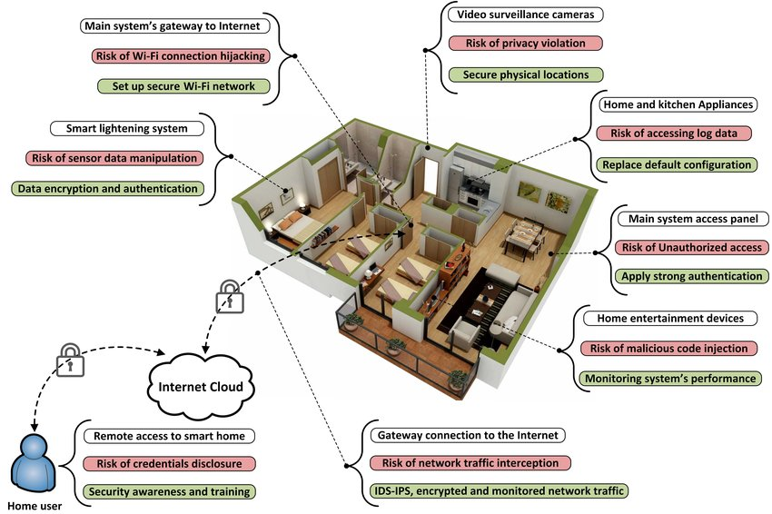
SECURITY SYSTEM IN SMART HOMES
Security risks
It is seen in past that any attack on IoT devices can harm millions of devices, as in Mirai and Hajime cases.
Security risks will cross over one IoT layers as shown in next

Slide 13
SECURITY SYSTEM IN SMART HOMES
Antivirus
Biometric Technology
Unique details
Measures
Use of antivirus software.
Use of Biometric Technology.
Remote access (WAN) of the system should be disabled.
Change default password.
Using a special username and password.

Slide 14
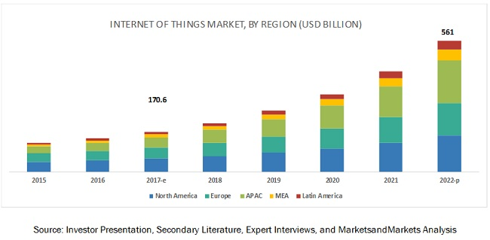
4. SCOPE FOR IMPROVEMENT
Market size is currently more in highly developed countries than developing countries, but it has scope in future.
A smart home is a modest growing technology in the beginning of the 19th century. But it has huge potential in the subsequent time.
According to a report of CISCO, by 2020 there are expected to be 50 billion IoT devices.
Market Potential

Slide 15
4. SCOPE FOR IMPROVEMENT
Ways to improve
Use of webserver
Security features
Independent operation of devices
User- friendly
Automatic functions
Solar charger

Slide 16
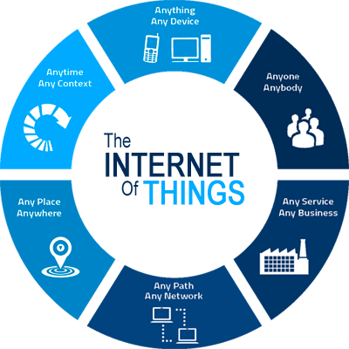
5. conclusion
IoT is bringing a new and revolutionary era in IT industries.
The main purpose of IoT is to make human life more easy and comfortable.
With improvement in some fields and making it more accessible, IoT based smart home appliances can be utilized most effectively.

Slide 17
THANK YOU

